Slide 1
Parallel Matrix Multiplication in Epiphany-16
CEG4136

Slide 2
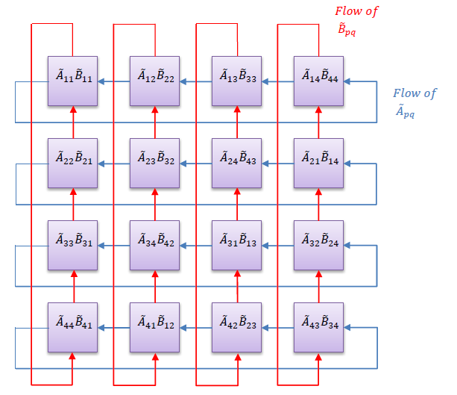
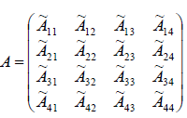
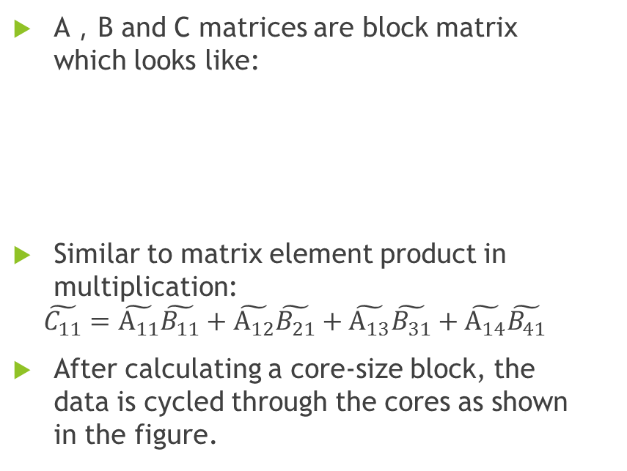
Matric parallel multiplication
A，B and C matrices are block matrix which looks like:
Similar to matrix element product in multiplication:
$$\tilde{C_{11}}=\tilde{A_{11}}\tilde{B_{11}}+\tilde{A_{12}}\tilde{B_{21}}+\tilde{A_{13}}\tilde{B_{31}}+\tilde{A_{14}}\tilde{B_{41}}$$
After calculating a core-size block, the data is cycled through the cores as shown in the figure.

Slide 3
Epiphany-16 Matrix Multiplication
1. Host writes Matrix Multiplication to cores
2. Host(ARM) allocates shared DRAM space for matrices A, B and C
3. Host signals Epiphany cores to start processing
4. Epiphany signals computation complete.
5. ARM cores calculates same results and compare result

Slide 4
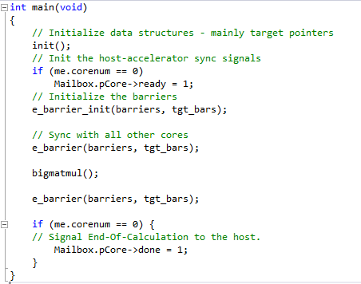
Device code (Epiphany cores)
Top level main waits for signal from the host, synchronized with all other cores to start calculation and informs host when complete.
A barrier is a means for synchronizing parallel executing threads. When a program reaches a barrier, it will wait until all other threads reached the barrier as well. Only then will the program (and all the other programs) continue their execution.

Slide 5
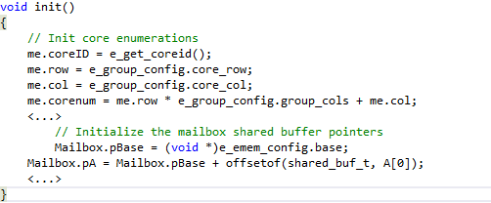
Device code
Init() function sets up core/address information, information on neighbours and DMA engines for efficient communication

Slide 6
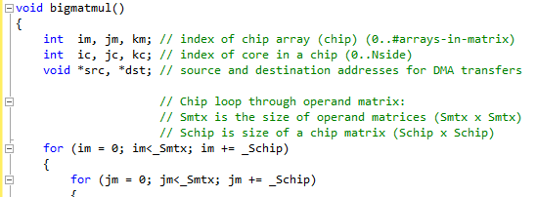
Device code
Bigmatmul() is set up to go through a “chip width” of the operand matrix at a time (if the whole matrix can fit in cores memory this will not be needed)

Slide 7
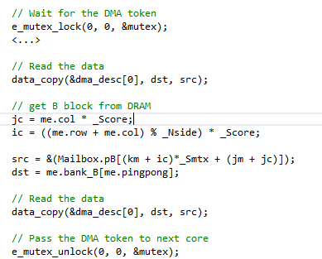
Device code
Each core then copies its submatrix A and B from DRAM to its internal memory, using a mutex on the DRAM
A mutex is an object which allows locking of a shared resource, enabling exclusive access to just one agent. When an access to the shared resource is required, first the associated mutex is checked. If the mutex is cleared, then resource is free. The mutex is then set and access is granted to the querying agent.

Slide 8
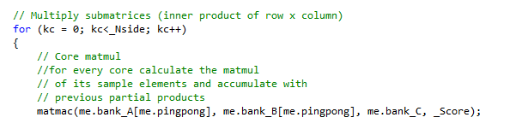
Device code
For the number of cores per side, the matrix is multiplied and added to a partial total
Matmac() is a the function to do actual matrix multiplication which is written in matlib.c

Slide 9
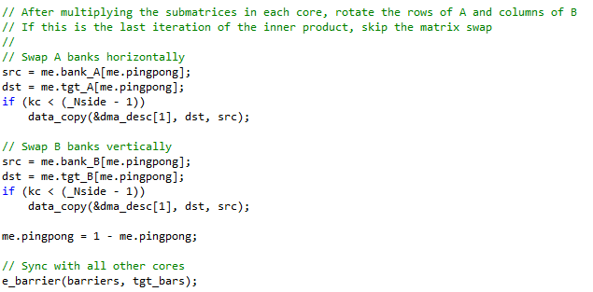
Device code
Each core then writes it’s a and B matrix to its neighbours memory for the next iteration.
Once all iterations are completed, the results are written to the C buffer in the same way A and B were initially read.

Slide 10
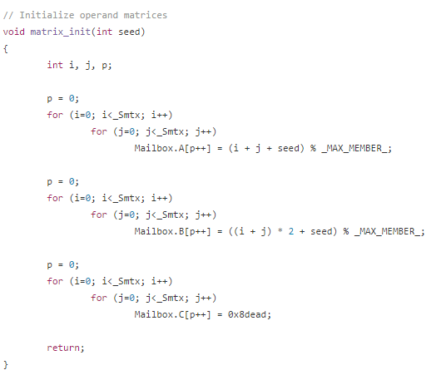
Host code (ARM cores)
The host code will start off the system. It will connect to the device for Epiphany system communication, clear mailbox contents and initialize operand matrix.

Slide 11
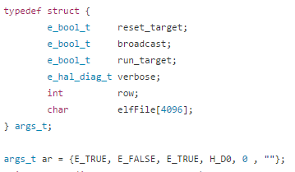
Host code
The function e_open() defines a workgroup (referenced by dev) starting at positions marked by row and col of the sizes specified. In this case, we want the workgroup to be defined just around core(0,0) and the workspace is the the platform size which is 16-core
Next, we use the e_load() function to move the object file onto a workgroup core. The coordinates that follow are relative to the workgroup (hence why it’s 0,0). It will load the device code to all cores according to 4,4 specification.

Slide 12
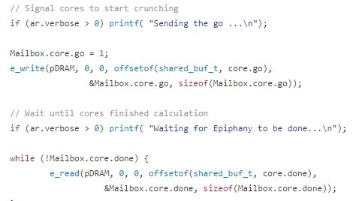
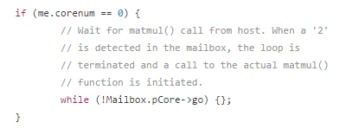
Host code
Then we signal the Epiphany cores to start working by sending the data over and ARM will stall and wait the calculation to finish.

Slide 13
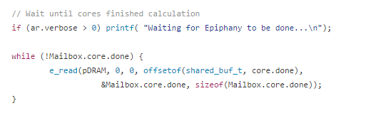
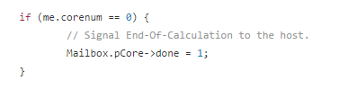
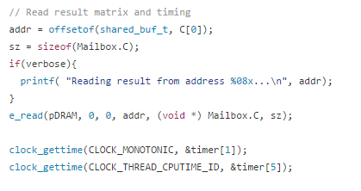
Host code
After device finish the calculation, it will send the data back the same way we sent it. And we also read the result and record the timing.

Slide 14
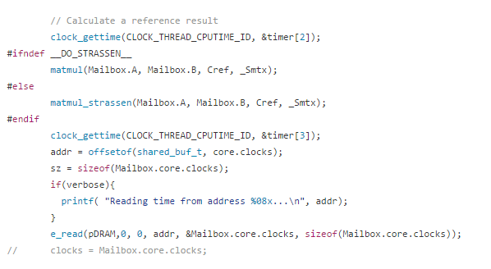
Host code
Then we also run a reference result that we do the same matrix multiplication just on ARM cores and record the timing to compare the calculating speed differential.

Slide 15
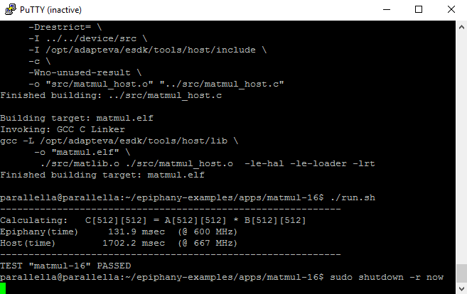
Build and run the code

Slide 16
Reference
Source code “matmul-16” https://github.com/adapteva/epiphany-examples/tree/2016.3/apps/matmul-16
“Scalable Parallel Multiplication of Big Matrices”. Yaniv Sapir Adapteva, Inc. http://www.adapteva.com/wp-content/uploads/2012/10/Scalable-Parallel-Multiplication-of-Big-Matrices.pdf
Epiphany SDK Reference. http://adapteva.com/docs/epiphany_sdk_ref.pdf
Epiphany SDK Examples (Simon Cook) - Preparing for Parallella. https://www.youtube.com/watch?v=5QvZsjMRtFI&list=PL_l8krpt_Qlgh0KzdZ_gBO8T2YSHkmI9D&index=5

